Slide 1
CHAPTER
7 Uncertainty

Slide 2
Mathematical Statistics
Random variable
  A variable that records, in numerical form, the possible outcomes from some random event
Probability density function (PDF)
  A function f(x) that shows the probabilities associated with the possible outcomes from a random variable

Slide 3
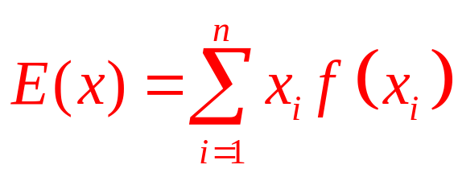
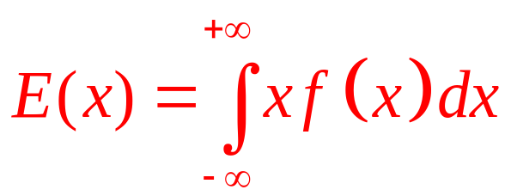
Mathematical Statistics
Expected value of a random variable
  The outcome of a random variable that will occur ‘‘on average’’
  The expected value is denoted by E(x)
  If x is a discrete random variable with n outcomes, then
  If x is a continuous random variable, then

Slide 4
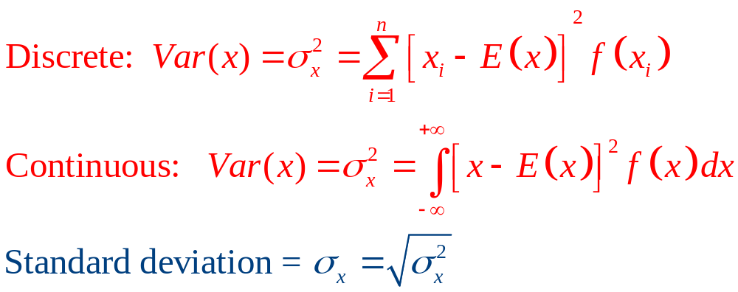
Mathematical Statistics
Variance and standard deviation of a random variable
  Measure the dispersion of a random variable about its expected value

Slide 5
Fair Gambles and The Expected
Utility Hypothesis
A ‘‘fair’’ gamble
  Specified set of prizes and associated probabilities that has an expected value of zero
  Common observation: people would prefer not to play fair games

Slide 6
St. Petersburg Paradox
A coin is flipped until a head appears
  If a head appears on the nth flip, the player is paid $2^{n}
    x₁ = $2, x₂ = $4, x₃ = $8,…,x_{n} = $2^{n}
  The probability of getting of getting a head on the ith trial is (½)^{i}
π₁=½, π₂= ¼,…, π_{n}= 1/2^{n}

Slide 7
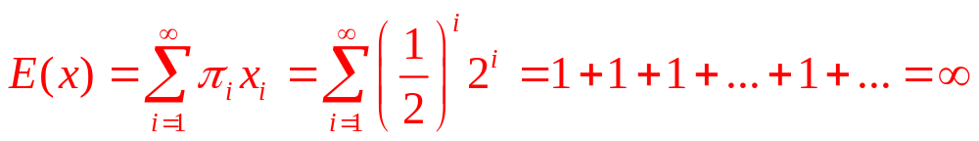
St. Petersburg Paradox
The expected value of the St. Petersburg paradox game is infinite
  Because no player would pay a lot to play this game, it is not worth its infinite expected value

Slide 8
Expected Utility
Individuals do not care directly about the dollar values of the prizes
  They care about the utility that the dollars provide
If we assume diminishing marginal utility of wealth
  The St. Petersburg game may converge to a finite expected utility value
    This would measure how much the game is worth to the individual

Slide 9
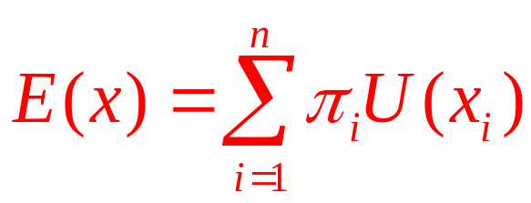
Expected Utility
Expected utility
  Can be calculated in the same manner as expected value
  Because utility may rise less rapidly than the dollar value of the prizes
    It is possible that expected utility will be less than the monetary expected value

Slide 10
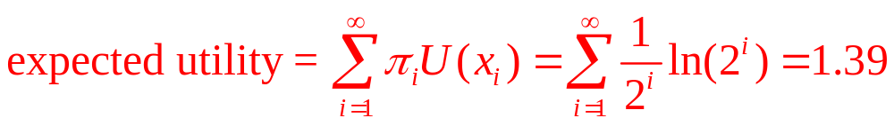
7.1 Bernoulli’s Solution to the Paradox and
Its Shortcomings
Utility of each prize in the St. Petersburg paradox is U(x_{i})=ln x_{i}
  Diminishing marginal utility (U’ > 0 but U’’ < 0),
  The expected utility value of this game converges to a finite number:

Slide 11
7.1 Bernoulli’s Solution to the Paradox and
Its Shortcomings
Bernoulli’s solution to the St. Petersburg paradox
  Does not completely solve the problem
  As long as there is no upper bound to the utility function
    The paradox can be regenerated by redefining the gamble’s prizes

Slide 12
The von Neumann-Morgenstern Theorem
Suppose that there are n possible prizes that an individual might win (x₁,…x_{n})
  Arranged in ascending order of desirability
  x₁ = least preferred prize ⇒ U(x₁) = 0
  x_{n} = most preferred prize ⇒ U(x_{n}) = 1
  Show that there is a reasonable way to assign specific utility numbers to the other prizes available

Slide 13
The von Neumann-Morgenstern Theorem
The von Neumann-Morgenstern method
  The utility of x_{i} - the expected utility of the gamble that the individual considers equally desirable to x_{i}
U(x_{i}) = π_{i} · U(x_{n}) + (1 - π_{i}) · U(x₁)
    Since U(x_{n}) = 1 and U(x₁) = 0
U(x_{i}) = π_{i} · 1 + (1 - π_{i}) · 0 = π_{i}
    The utility number attached to any other prize is simply the probability of winning it
    This choice of utility numbers is arbitrary

Slide 14
Expected Utility Maximization
Consider two gambles:
  Gamble A offers x₂ with probability a and x₃ with probability (1-a)
  expected utility of A= E_{A}[U(x)] = a · U(x₂) + (1-a) · U(x₃)
  Gamble B offers x₄ with probability b and x₅ with probability (1-b)
  expected utility of B= E_{B}[U(x)] = b · U(x₄) + (1-b) · U(x₅)

Slide 15
Expected Utility Maximization
  Substituting the utility index numbers gives
E_{A}[U(x)] = a · π₂ + (1-a) · π₃
E_{B}[U(x)] = b · π₄ + (1-b) · π₅
The individual will prefer gamble 1 to gamble 2 if and only if
E_{A}[U(x)] > E_{B}[U(x)]
a · π₂ + (1-a) · π₃ > b · π₄ + (1-b) · π₅

Slide 16
Expected Utility Maximization
Expected utility maximization
  If individuals obey the von Neumann-Morgenstern axioms of behavior in uncertain situations
  They will act as if they choose the option that maximizes the expected value of their von Neumann-Morgenstern utility index

Slide 17
Risk Aversion
Two lotteries
  May have the same expected value but differ in their riskiness
Risk
  The variability of the outcomes of some uncertain activity
When faced with two gambles
  With the same expected value, individuals will usually choose the one with lower risk

Slide 18
Risk Aversion
Assumption: marginal utility of wealth falls as wealth gets larger
  A flip of a coin for $1,000
    Small gain in utility if you win
    Large loss in utility if you lose
  A flip of a coin for $1
    Inconsequential: gain in utility from a win is not much different as the drop in utility from a loss

Slide 19
Risk Aversion
Risk aversion and fair gambles
    W₀ represents an individual’s current wealth
    U(W) is a von Neumann-Morgenstern utility function
Gamble A: a 50-50 chance of winning/losing $h
  U(W₀) = utility of initial wealth, W₀
  Expected utility: E_{A}[U(W)] = ½ U(W₀+h) + ½ U(W₀-h)
  Winning a fair bet adds to enjoyment less than losing hurts: U(W₀) > E_{A}[U(W)]

Slide 20
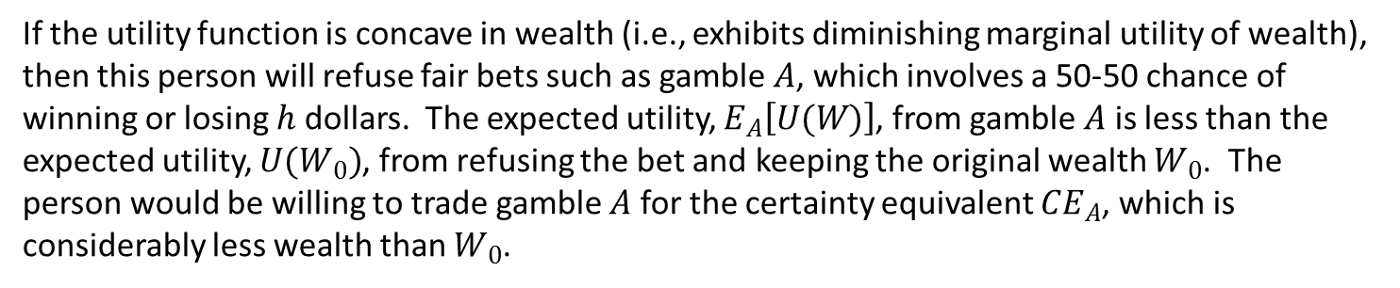
7.1 Utility of Wealth Facing a Fair Bet
Utility (U)
U(W)
U(W₀)
E_{A}[U(W)]=U(CE_{A})
Wealth (W)
W₀-h
CE_{A}
W₀
W₀+h
If the utility function is concave in wealth (i.e., exhibits diminishing marginal utility of wealth), then this person will refuse fair bets such as gamble $A$, which involves a 50-50 chance of winning or losing $h$ dollars. The expected utility, $E_{A}\left[U(W)\right]$, from gamble $A$ is less than the expected utility, $U(W_{0})$, from refusing the bet and keeping the original wealth $W_{0}$. The person would be willing to trade gamble $A$ for the certainty equivalent ${CE}_{A}$, which is considerably less wealth than $W_{0}$.

Slide 21
Risk Aversion
Gamble B: a 50-50 chance of winning/losing $2h
  Expected utility: E_{B}[U(W)] = ½ U(W₀+2h) + ½ U(W₀-2h)
Because the outcomes are more variable in gamble B than A
  The expected utility of B is lower, and so the person prefers A to B
  U(W₀) > E_{A}[U(W)] > E_{B}[U(W)]

Slide 22
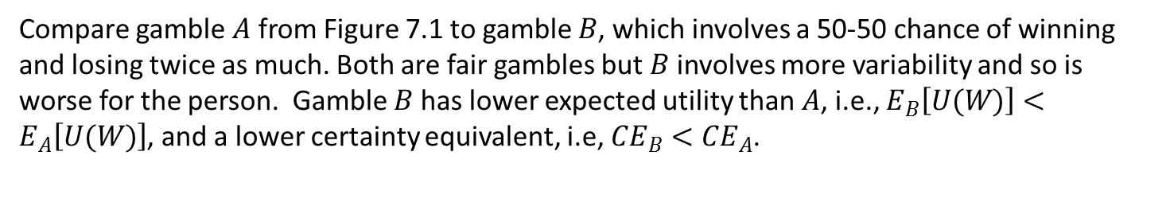
7.2 Comparing Two Fair Bets of Differing
Variability
Utility (U)
U(W₀)
U(W)
E_{A}[U(W)]=U(CE_{A})
E_{B}[U(W)]=U(CE_{B})
Wealth (W)
W₀-2h
W₀-h
W₀
W₀+h
W₀+2h
CE_{B}
CE_{A}
Compare gamble $A$ from Figure 7.1 to gamble $B$, which involves a 50-50 chance of winning and losing twice as much. Both are fair gambles but $B$ involves more variability and so is worse for the person. Gamble $B$ has lower expected utility than $A$, i.e., $E_{B}\left[U(W)\right]<E_{A}\left[U(W)\right]$, and a lower certainty equivalent, i.e, ${CE}_{B}<{CE}_{A}$.

Slide 23
Risk Aversion and Insurance
Risk aversion
  An individual who always refuses fair bets is said to be risk averse
  If individuals exhibit a diminishing marginal utility of wealth, they will be risk averse
  As a consequence, they will be willing to pay something to avoid taking fair bets

Slide 24
7.2 Willingness to Pay for Insurance
A person with a current wealth of $100,000
  Faces a 25% chance of losing his automobile worth $20,000
  Von Neumann-Morgenstern utility index is:
  U(W) = ln (W)
  Expected utility without insurance
    E_{no}[U(W)] = 0.75U(100,000) + 0.25U(80,000) = 0.75 ln100,000+0.25 ln80,000 = 11.45714
  Expected utility of fair insurance
    E_{fair}[U(W)]=U(95,000)=ln 95,000 = 11.46163

Slide 25
7.2 Willingness to Pay for Insurance
  Expected utility from a policy charging maximum insurance premium:
    E_{wtp}[U(W)]= U(100,000 – x) = ln (100,000 – x) =11.45714
  So x=5,426
This person
  Would be willing to pay up to $426 in administrative costs to an insurance company
  In addition to the $5,000 premium to cover the expected value of the loss
  Is as well off as he or she would be when facing the world uninsured

Slide 26
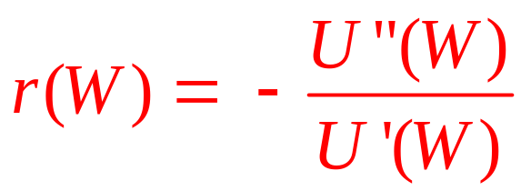
Measuring Risk Aversion
The most commonly used risk aversion measure was developed by Pratt
For risk averse individuals, U”(W) < 0
  r(W) will be positive for risk averse individuals
  r(W) is not affected by which von Neumann-Morganstern ordering is used

Slide 27
Measuring Risk Aversion
The Pratt measure of risk aversion
  Is proportional to the amount an individual will pay to avoid a fair gamble
  h - winnings from a fair bet, E(h) = 0
  p - size of the insurance premium
    That would make the individual exactly indifferent between taking the fair bet h and paying p with certainty to avoid the gamble
E[U(W + h)] = U(W - p)

Slide 28
Measuring Risk Aversion
Expand both sides of the equation using Taylor’s series
  Because p is a fixed amount, we can use a simple linear approximation to the right-hand side
U(W - p) = U(W) - pU’(W) + higher order terms
E[U(W + h)] = E[U(W) - hU’(W) + h²/2 U” (W) + higher order terms
E[U(W + h)] = U(W) - E(h)U’(W) + E(h²)/2 U” (W) + higher order terms

Slide 29
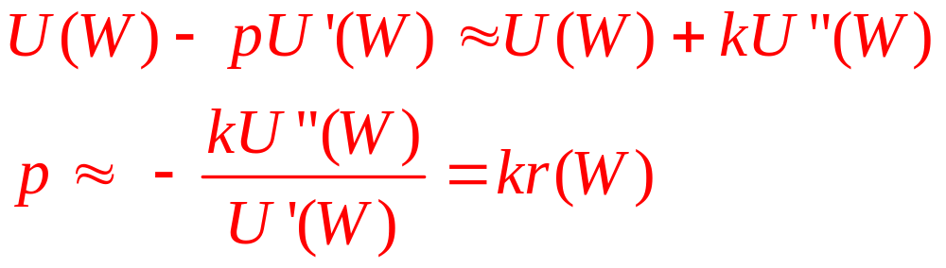
Measuring Risk Aversion
  E(h)=0
  Drop the higher order terms
  Substituting k for E(h²)/2, we get

Slide 30
Risk Aversion and Wealth
It is not necessarily true that risk aversion declines as wealth increases
  Diminishing marginal utility
    Would make potential losses less serious for high-wealth individuals
    Makes the gains from winning gambles less attractive
  The net result depends on the shape of the utility function

Slide 31
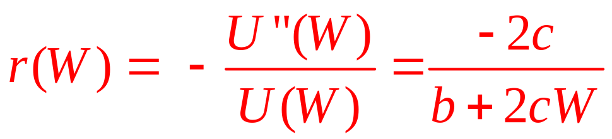
Risk Aversion and Wealth
If utility is quadratic in wealth,
U(W) = a + bW + cW ²
  Where b > 0 and c < 0
  Pratt’s risk aversion measure is
  Risk aversion increases as wealth increases

Slide 32
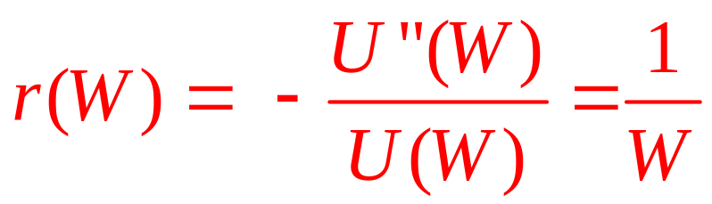
Risk Aversion and Wealth
If utility is logarithmic in wealth,
U(W) = ln (W )
  Where W > 0
  Pratt’s risk aversion measure is
  Risk aversion decreases as wealth increases

Slide 33
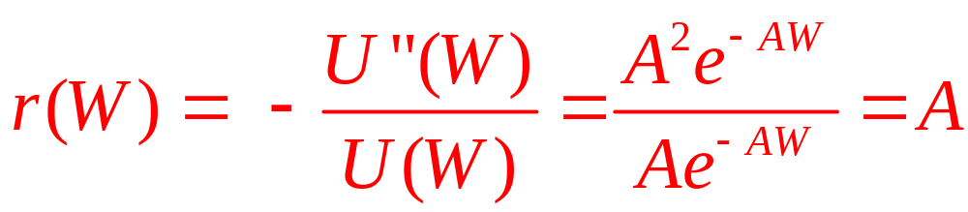
Risk Aversion and Wealth
If utility is exponential,
U(W) = –e^{–AW}
  Where A is a positive constant
  Pratt’s risk aversion measure is
  Risk aversion is constant as wealth increases

Slide 34
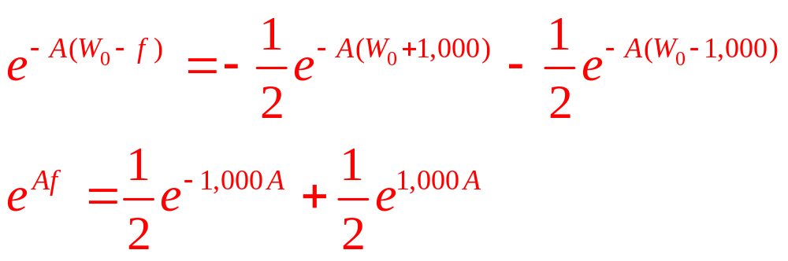
7.3 Constant Risk Aversion
How much ( f ) would an individual pay to avoid the risk?
  Initial wealth is W₀
  Utility function exhibits constant absolute risk aversion
  A 50–50 chance of winning or losing $1,000
  To find f, we set the utility of W₀-f equal to the expected utility from the gamble

Slide 35
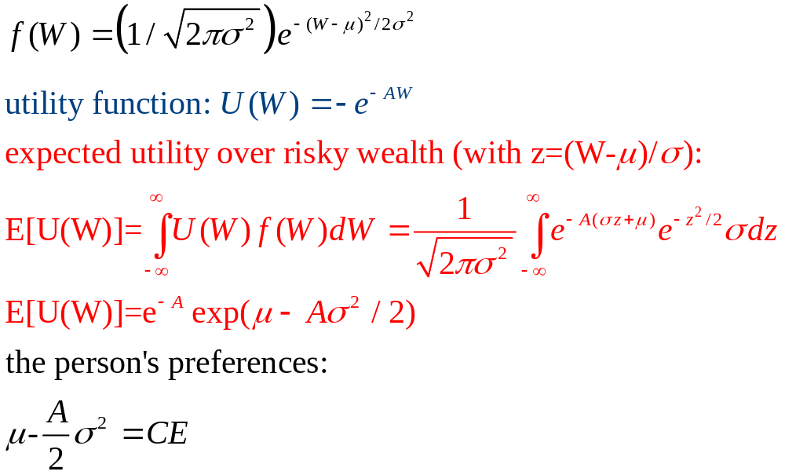
7.3 Constant Risk Aversion
If wealth W is a Normal random variable with mean μ and variance σ²
  The probability density function for wealth:

Slide 36
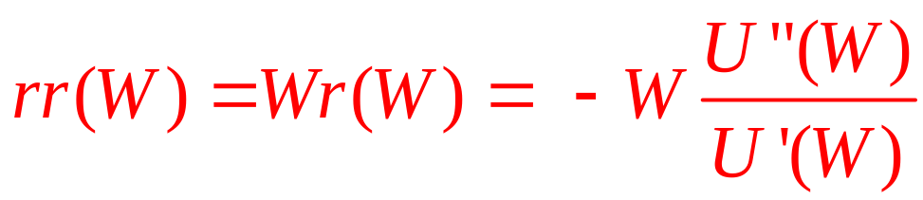
Relative Risk Aversion
Unlikely
  Willingness to pay to avoid a gamble is independent of wealth
More appealing assumption
  Willingness to pay is inversely proportional to wealth
Relative risk aversion:

Slide 37
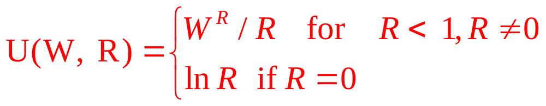
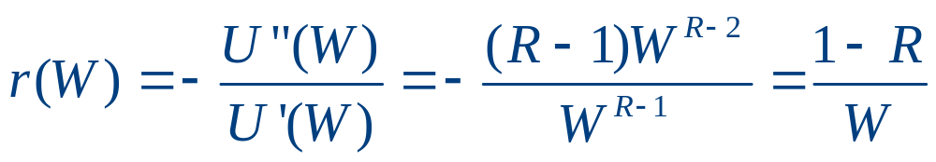
Relative Risk Aversion
The power utility function
  Diminishing absolute relative risk aversion
  But constant relative risk aversion

Slide 38
7.4 Constant Relative Risk Aversion
Constant relative risk aversion utility function
  What fraction of initial wealth ( f )
    Willing to give up to avoid a fair gamble of, 10% of initial wealth
  Assume R = 0
  Logarithmic utility function
    ln[(1-f)W₀] = 0.5 ln(1.1W₀) + 0.5 ln(0.9W₀)
    ln(1-f) = 0.5 ln(1.1) + 0.5 ln(0.9) = ln(0.99)^{0.5}
    f=0.005
  Sacrifice up to 0.5 percent of wealth to avoid the 10 percent gamble

Slide 39
Methods for Reducing Uncertainty and Risk
Four different methods that individuals can take to mitigate the problem of risk and uncertainty:
  Insurance
  Diversification
  Flexibility
  Information

Slide 40
Insurance
Risk-averse people
  Pay a premium to have the insurance company cover the risk of loss
  Would always want to buy fair insurance to cover any risk he or she faces
Insurance company
  Cannot stay in business if it offered fair insurance
    Premium = the expected payout for claims

Slide 41
Insurance
An insurance customer
  Can always expect to pay more than an actuarially fair premium
If people are sufficiently risk averse
  They will even buy unfair insurance
  The more risk averse they are, the higher the premium they would be willing to pay

Slide 42
Insurance
Factors that make insurance difficult or impossible to provide
  Large-scale disasters
  Rare and unpredictable events
  Informational disadvantage the company may have relative to the customer
    Adverse selection problem
  Moral hazard problem

Slide 43
Diversification
Diversification
  Suitably spreading risk around - to reduce the variability of an outcome without lowering the expected payoff
A person has wealth W to invest
  Can be invested in two independent risky assets, 1 and 2
    Equal expected values (μ₁=μ₂)
    Equal variances (σ²₁=σ²₂)

Slide 44
Diversification
Undiversified portfolio, UP
  Includes just one of the assets
  Expected return: μ_{UP} = μ₁=μ₂
  Variance: σ²_{UP} = σ²₁=σ²₂

Slide 45
Diversification
Diversified portfolio, DP
    α₁ – the fraction invested in the first asset
    (1- α₁) – the fraction invested in the second
  Expected return:
  μ_{DP} = α₁ μ₁+(1- α₁)μ₂= μ₁=μ₂
  Variance;
  σ²_{DP} = α²₁ σ²₁+(1- α₁)² σ²₂ = (1-2α₁+ 2α²₁ ) σ²₁
  Minimize σ²_{DP}
  α₁ = ½ ; σ²_{DP}= σ²₁/2

Slide 46
Flexibility
Flexibility
  Allows the person to adjust the initial decision depending on how the future unfolds
  The more uncertain the future, the more valuable this flexibility
  Keeps the decision-maker from being tied to one course of action
    And instead provides a number of options

Slide 47
Flexibility
Financial option contract
  Offers the right, but not the obligation, to buy or sell an asset
    During some future period
    At a certain price
Real option
  An option arising in a setting outside of financial markets

Slide 48
Flexibility
All options share three fundamental attributes
  Specify the underlying transaction
  Specify a period over which the option may be exercised
  Specifies a price

Slide 49
Flexibility
Model of real options
  Let x embody all the uncertainty in the economic environment
  The individual has some number, i = 1,…,n, of choices currently available
  O_{i}(x) - payoffs provided by choice i
    (x) allows each choice to provide a different pattern of returns depending on how the future turns out

Slide 50
Flexibility
Model of real options
  No flexibility
    Choose the single alternative that is best on average
    Expected utility from this choice: max{E[U(O₁)] ,…, E[U(O_{n})]}
  Flexibility
    Choose the best alternative
    Expected utility: E{max[U(O₁),…,U(O_{n})]}

Slide 51
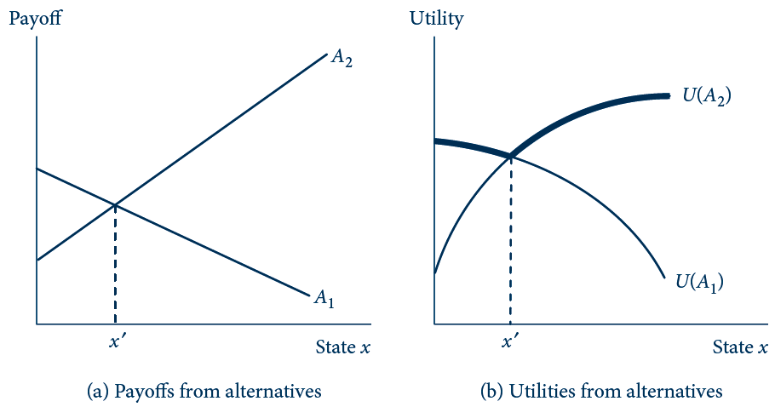
7.3 The Nature of a Real Option
O₂
U(O₂)
U(O₁)
O₁
Panel (a) shows the payoffs and panel (b) shows the utilities provided by two alternatives across states of the world (x). If the decision has to be made upfront, the individual chooses the single curve having the highest expected utility. If the real option to make either decision can be preserved until later, the individual can obtain the expected utility of the upper envelope of the curves, shown in bold.

Slide 52
Flexibility
More options are better (generally)
  Options give the holder the right—but not the obligation—to choose them
In a strategic setting
  Economic actors may benefit from having some of their options cut off
    Allow a player to commit to a narrower course of action
    This commitment may affect the actions of other parties

Slide 53
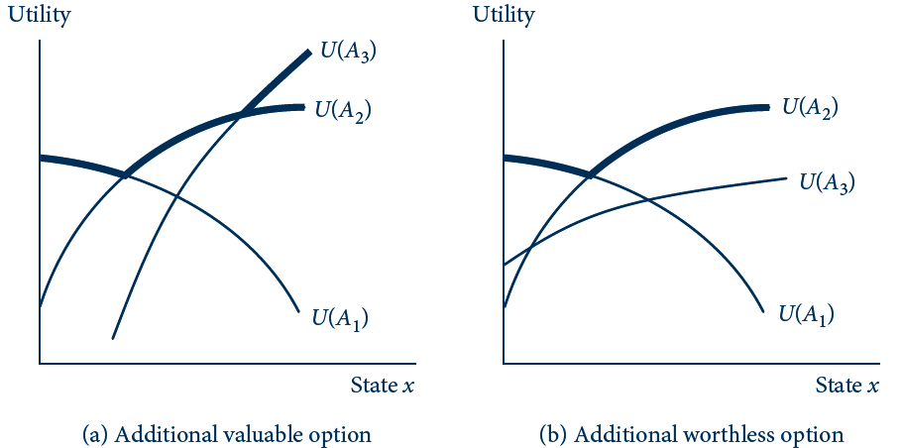
7.4 More Options Cannot Make the Individual
Decision-Maker Worse Off
U(O₃)
U(O₂)
U(O₃)
U(O₂)
U(O₁)
U(O₁)
The addition of a third alternative to the two drawn in Figure 7.3 is valuable in (a) because it shifts the upper envelope (shown in bold) of utilities up. The new alternative is worthless in (b) because it does not shift the upper envelope, but the individual is not worse off for having it.

Slide 54
Flexibility
Computing option value
  Let F be the fee that has to be paid
    For the ability to choose the best alternative after x has been realized instead of before
  The individual would be willing to pay the fee as long as:
  E{max[U(O₁(x)-F),…,U(O_{n}(x)-F)]} ≥ max{E[U(O₁(x)] ,…, E[U(O_{n}(x)]}

Slide 55
7.5 Value of a Flexible-Fuel Car
O₁(x)= 1-x
  The payoff from a fossil-fuel–only car
O₂(x) = x
  The payoff from a biofuel-only car
State of the world, x
  Reflects the relative importance of biofuels compared with fossil fuels over the car’s lifespan
  Random variable, uniformly distributed between 0 and 1

Slide 56
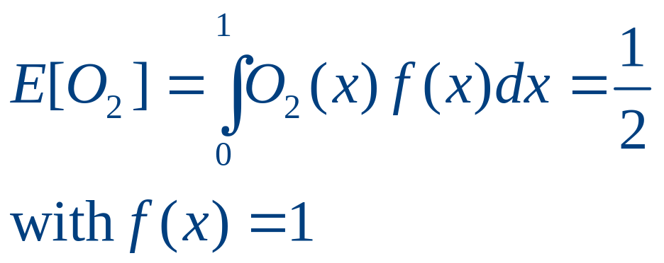
7.5 Value of a Flexible-Fuel Car
Probability density function (PDF) is f (x) = 1
  When the uniform random variable ranges between 0 and 1
Suppose first that the car buyer is risk neutral
  Utility level = payoff level
  Forced to choose a biofuel car
  Expected utility:

Slide 57
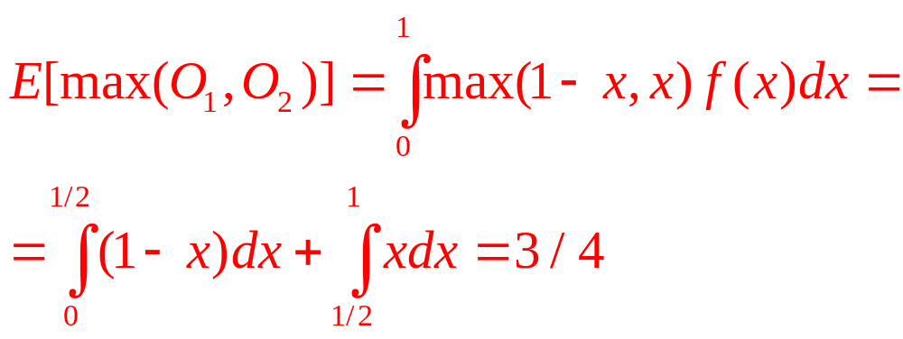
7.5 Value of a Flexible-Fuel Car
Risk neutrality
  Flexible-fuel car is available
  Buyer: either O₁(x) or O₂(x), whichever is higher under the latter circumstances
  Expected utility:

Slide 58
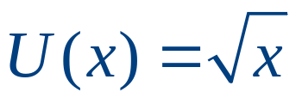
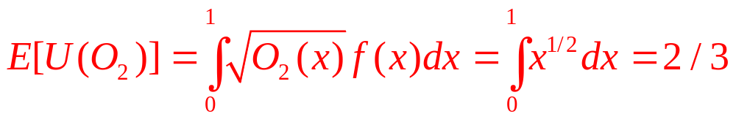
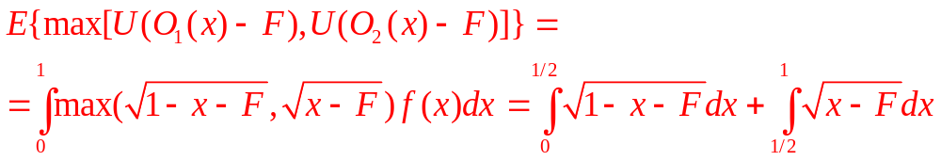
7.5 Value of a Flexible-Fuel Car
Risk aversion,
  Expected utility from a biofuel car:
  Expected utility from a fossil-fuel car; E[U(O₁)]=2/3
  Expected utility from a flexible-fuel car that costs F more than a single-fuel car:

Slide 59
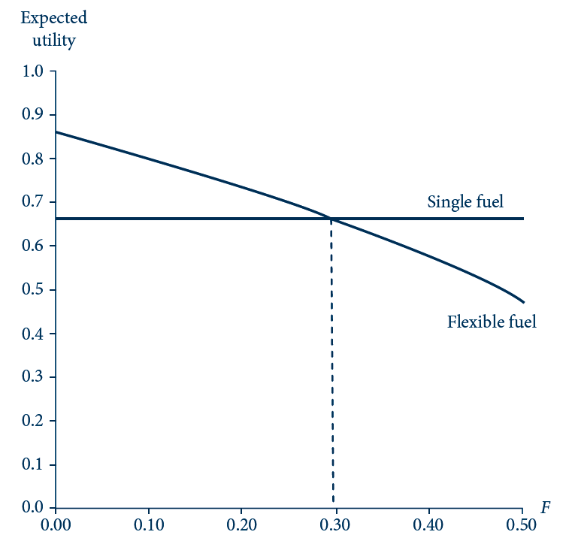
7.5 Graphical Method for Computing the
Premium for a Flexible-Fuel Car
To find the maximum premium F that the risk-averse buyer would be willing to pay for the flexible-fuel car, we plot the expected utility from a single-fuel car from Equation 7.55 (E[U(O₂)]) and from the flexible-fuel car from Equation 7.56 (E{max[U(O₁(x)-F), U(O₂(x)-F)]})and see the value of F where the curves cross.

Slide 60
Flexibility
Option value of delay
  Delay preserves options
  If circumstances continue to be favorable or become even more so, the action can still be taken later
  But if the future changes and the action is unsuitable, the decision-maker may have saved a lot of trouble by not making it

Slide 61
Flexibility
The cost–benefit rule
  An action should be taken if anticipated costs are less than benefits
  Correct course of action in simple settings without uncertainty
  In settings involving uncertainty
    Account for risk preferences
    Account for the option value of delay

Slide 62
Information
Information
  Difficult to quantify
  Has some technical properties that make it an unusual sort of good
    Durable and retains value after it has been used
      Pure public good: non-rival and non-exclusive

Slide 63
Information
Quantifying the value of information
  Individual is uncertain about what the state of the world (x) will be in the future
    Needs to make one of n choices today
    O_{i}(x) represents the payoffs provided by choice I
    F - the fee charged to be told the exact value that x will take on in the future; maximum F:
  E{max[U(O₁(x)-F),…,U(O_{n}(x)-F)]}= max{E[U(O₁(x)] ,…, E[U(O_{n}(x)]}

Slide 64
The State-Preference Approach to
Choice Under Uncertainty
Outcomes of any random event
  Can be categorized into a number of states of the world
  “Good times” or “bad times”
Contingent commodities
  Goods delivered only if a particular state of the world occurs
  “$1 in good times” or “$1 in bad times”

Slide 65
States of the World
It is conceivable that an individual could purchase a contingent commodity
  Buy a promise that someone will pay you $1 if tomorrow turns out to be good times
  This good will probably sell for less than $1

Slide 66
Utility Analysis
Assume two contingent goods
  Wealth in good times (w_{g}) and wealth in bad times (w_{b})
  Individual believes the probability that bad times will occur is π
  Expected utility: E[U(W)]= (1- π)U(W_{g}) + πU(W_{b})
    This is the value that the individual wants to maximize given his initial wealth (W)

Slide 67
Prices of Contingent Commodities
Assume
  The person can buy $1 of wealth in good times for p_{g} and $1 of wealth in bad times for p_{b}
  His budget constraint: W₀ = p_{g}W_{g} + p_{b}W_{b}
The price ratio p_{g} /p_{b}
  Shows how this person can trade dollars of wealth in good times for dollars in bad times

Slide 68
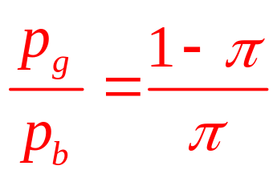
Fair Markets for Contingent Goods
If markets for contingent wealth claims
  Are well-developed
  And there is general agreement about π
  Prices for these claims will be actuarially fair: p_{g} = 1-π and p_{b} = π
  The price ratio will reflect the odds in favor of good times

Slide 69
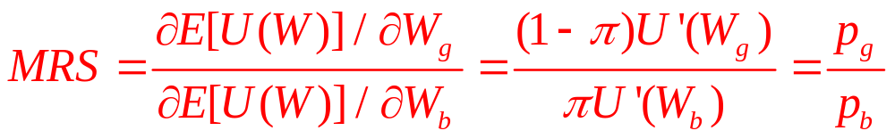
Risk Aversion
If contingent claims markets are fair
  A utility-maximizing individual will opt for a situation in which W_{g} = W_{b}
    Arrange matters so that the wealth obtained is the same no matter what state occurs
  Maximization of utility subject to a budget constraint:

Slide 70
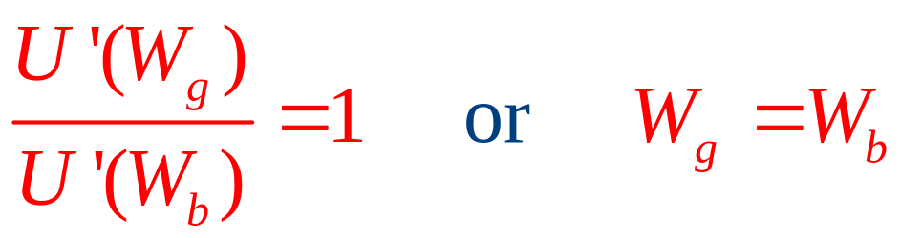
Risk Aversion
If markets for contingent claims are fair
When faced with fair markets in contingent claims on wealth
  Individual will be risk averse
  And will choose to ensure that he or she has the same level of wealth regardless of which state occurs

Slide 71
7.6 Risk Aversions in the State-Preference Model
W_{b}
certainty line
W₀
U₁
I
I’
W_{g}
W₀
The line I represents the individual’s budget constraint for contingent wealth claims: W₀ = p_{g}W_{g} + p_{b}W_{b}. If the market for contingent claims is actuarially fair [p_{g} /p_{b} = (1-π)/ π], then utility maximization will occur on the certainty line where W_{g} = W_{b} = W₀. If prices are not actuarially fair, the budget constraint may resemble I’, and utility maximization will occur at a point where W_{g} > W_{b}.

Slide 72
7.6 Insurance in the State-Preference Model
A person with wealth of $100,000
  Faces a 25% chance of losing his automobile worth $20,000
  Wealth with no theft (W_{0g}) = $100,000 and probability of no theft = 0.75
  Wealth with a theft (W_{0b}) = $80,000 and probability of a theft = 0.25
  Assume logarithmic utility, then expected utility:
E[U(W)] = 0.75U(W_{g})+0.25U(W_{b})=0.75ln W_{g} + 0.25ln W_{b}
E(U) = 11.45714

Slide 73
7.6 Insurance in the State-Preference Model
The budget constraint
  Written in terms of the prices of the contingent commodities
p_{g}W_{0g}* + p_{b}W_{0b}* = p_{g}W_{g} + p_{b}W_{b}
  Assuming that these prices equal the probabilities of these two states
0.75(100,000) + 0.25(80,000) = 95,000
  The expected value of wealth = $95,000

Slide 74
7.6 Insurance in the State-Preference Model
The individual will move to the certainty line and receive an expected utility of
E_{B}[U(W)] = ln 95,000 = 11.46163
  To be able to do so, the individual must be able to transfer $5,000 in extra wealth in good times into $15,000 of extra wealth in bad times
    A fair insurance contract will allow this
    The wealth changes promised by insurance (dW_{b}/dW_{g}) = 15,000/-5,000 = -3

Slide 75
7.6 Insurance in the State-Preference Model
A policy with a deductible provision, C
  Insurance policy costs $4,900, but requires the person to incur the first $1,000 of the loss
  W_{g} = 100,000 - 4,900 = 95,100
  W_{b} = 80,000 - 4,900 + 19,000 = 94,100
  E_{C}[U(W)] = 0.75 ln 95,100 + 0.25 ln 94,100
  E(U) = 11.46004
  The policy still provides higher utility than doing nothing

Slide 76
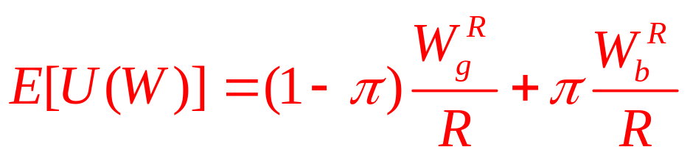
Risk Aversion and Risk Premiums
Two people
  Each starts with an initial wealth of W₀
  Each seeks to maximize an expected utility function of the form
  Constant relative risk aversion
  R determines the degree of risk aversion
  R determines the degree of curvature of indifference curves implied by the function
  A very risk averse individual- a large negative R

Slide 77
7.7 Risk Aversion and Risk Premiums
W_{b}
certainty line
W₀
W₀ - h
U₁
U₂
W_{g}
W₀
W₂
W₁
Indifference curve U₁ represents the preferences of a risk-averse person, whereas the person with preferences represented by U₂ is willing to assume more risk. When faced with the risk of losing h in bad times, person 2 will require compensation of W₂ – W₀ in good times, whereas person 1 will require a larger amount given by W₁ – W₀.

Slide 78
Asymmetry of Information
The level of information that a person buys
  Will depend on the price per unit
Information costs may differ significantly across individuals
  Specific skills for acquiring information
  Experience that is relevant
  Different former investments in information services

Slide 79
The Portfolio Problem
Basic model with one risky asset
  Assume an individual has wealth (W₀) to invest in one of two assets
  One asset yields a certain return of r_{f}
  One asset’s return is a random variable, r
  k - the amount invested in the risky asset

Slide 80
The Portfolio Problem
The person’s wealth at the end of one period
W = (W₀ – k)(1 + r_{f}) + k(1 + r)
W = W₀(1 + r_{f}) + k(r – r_{f})
  W is now a random variable: it depends on r
  k can be positive or negative: can buy or sell short
  k can be greater than W₀: the investor could borrow at the risk-free rate

Slide 81
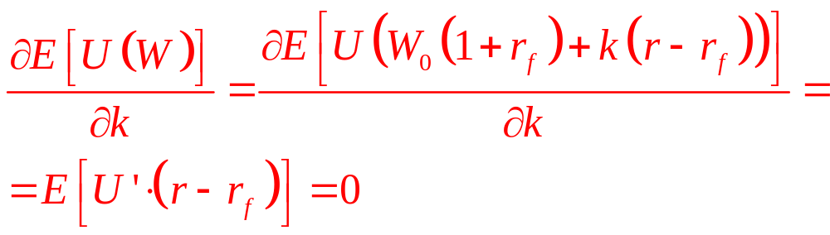
The Portfolio Problem
U(W) - the investor’s utility function
  The von Neumann-Morgenstern theorem: he will choose k to maximize E[U(W)]
The first-order condition:

Slide 82
The Portfolio Problem
As long as E(r – r_{f}) > 0
  An investor will choose positive amounts of the risky asset
As risk aversion increases
  The amount of the risky asset held will fall
  The shape of the U’ function will change

Slide 83
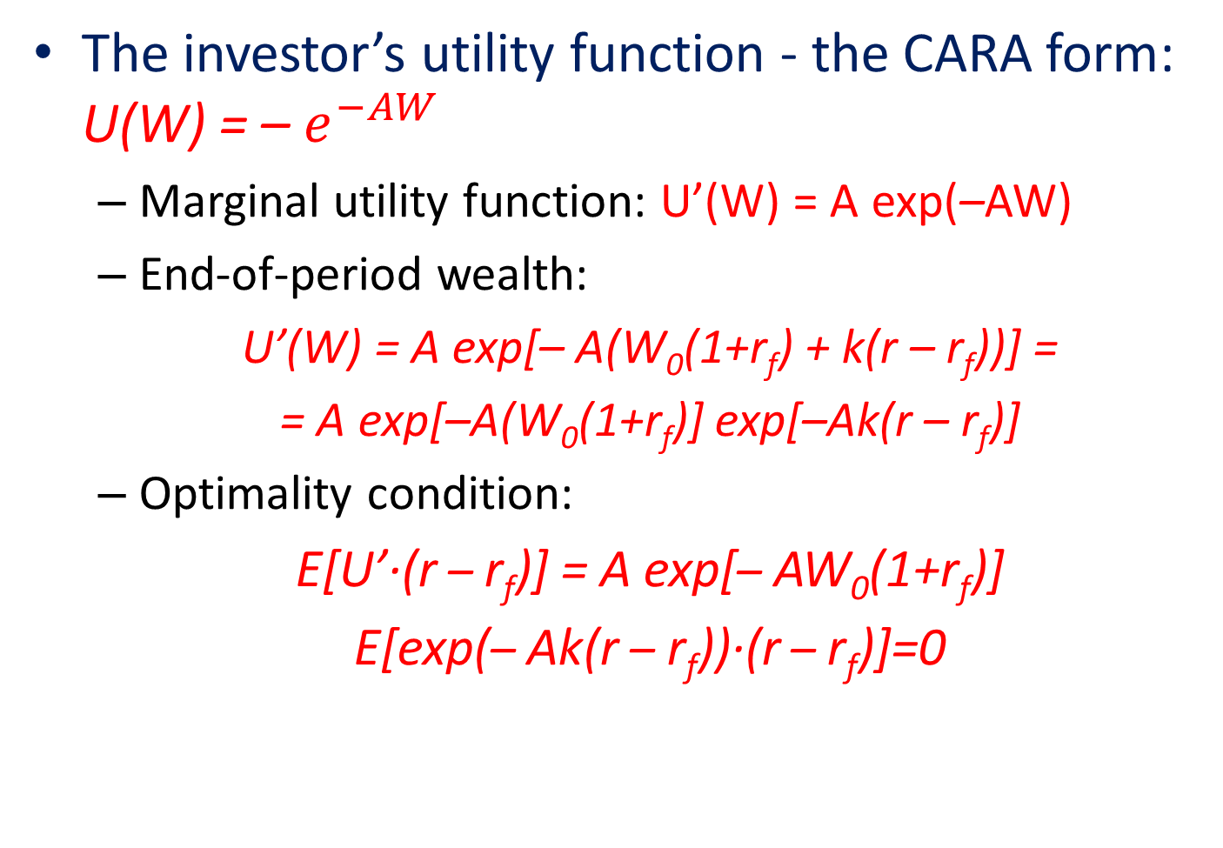
CARA utility
The investor’s utility function - the CARA form: U(W) = – $e^{−AW}$
  Marginal utility function: U’(W) = A exp(–AW)
  End-of-period wealth:
  U’(W) = A exp[– A(W₀(1+r_{f}) + k(r – r_{f}))] =
  = A exp[–A(W₀(1+r_{f})] exp[–Ak(r – r_{f})]
  Optimality condition:
  E[U’·(r – r_{f})] = A exp[– AW₀(1+r_{f})]
  E[exp(– Ak(r – r_{f}))·(r – r_{f})]=0

Slide 84
CARA utility
CARA function
  Implies that the fraction of wealth that an investor holds in risky assets should decrease as wealth increases
CRRA form
  All individuals with the same risk tolerance
    Will hold the same fraction of wealth in risky assets
    Regardless of their absolute levels of wealth

Slide 85
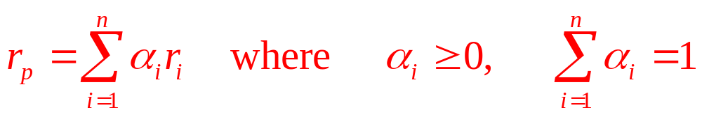
Portfolios of many risky assets
Return on each of n risky assets
  The random variable r_{i} (i = 1,…, n)
  Expected values: E(r_{i})=μ_{i}
  Variances: Var(r_{i}) = σ²_{i}
  An investor who invests a portion of his or her wealth in a portfolio of these assets will obtain a random return:

Slide 86
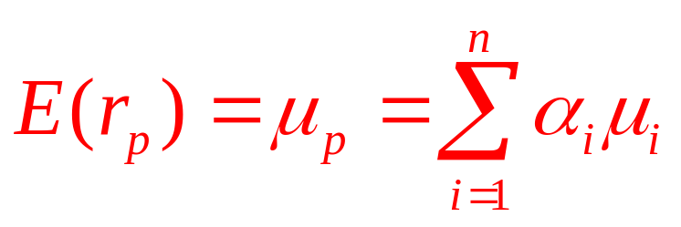
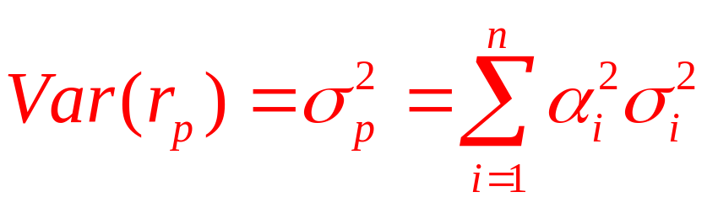
Portfolios of many risky assets
Expected return on this portfolio
If the returns of each asset are independent
  The variance of the portfolio’s return:

Slide 87
Optimal portfolios
Solving the optimal portfolio problem
  The first step: consider portfolios of just the risky assets
  The second step: add in the riskless one
Optimal portfolio of just the risky assets
  Choose a general set of asset weightings (the α_{i})
    Minimize the variance (or standard deviation)
  “Efficiency frontier’’ for risky asset portfolios

Slide 88
Optimal portfolios
Add a risk-free asset
  With expected return μ_{f}
  And standard deviation σ_{f} = 0
Optimal portfolios
  ‘‘Market portfolio’’ consisting of all capital assets held in proportion to their market valuations
    Expected return μ_{m}
    Standard deviation σ_{m}

Slide 89
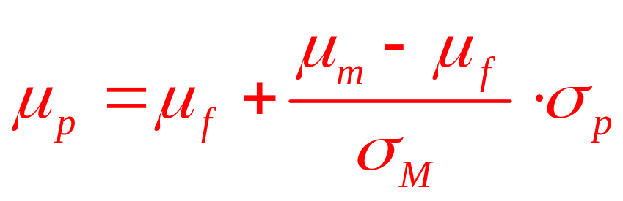
Optimal portfolios
Mixed portfolio (line RP)
  Permits individual investors to ‘‘purchase’’ returns in excess of the risk-free return (μ_{M}-μ_{f}) by taking on proportionally more risk (σ_{p}/σ_{M})
  Points to the left of the market point M: σ_{p}/σ_{M}<1 and μ_{f} < μ_{p} < μ_{M}
  High-risk points to the right of M: σ_{p}/σ_{M}>1 and μ_{p} > μ_{M}

Slide 90
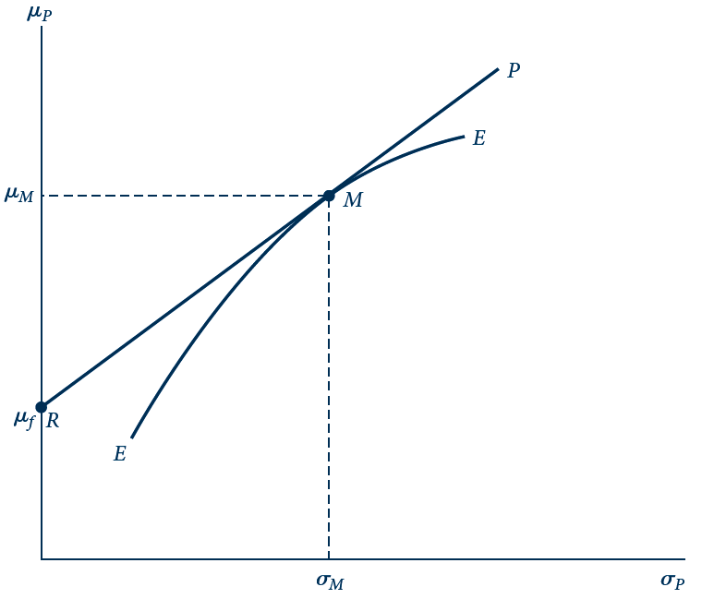
E 7.1 Efficient Portfolios
The frontier EE represents optimal mixtures of risky assets that minimize the standard deviation of the portfolio, σ_{P}, for each expected return, μ_{P}. A risk-free asset with return μ_{f} offers investors the opportunity to hold mixed portfolios along RP that mix this risk-free asset with the market portfolio, M.

Slide 91
Individual choices
Individuals with low tolerance for risk (I )
  Opt for portfolios that are heavily weighted toward the risk-free asset
Investors willing to assume a modest degree of risk (II )
  Opt for portfolios close to the market portfolio
High-risk investors (III )
  Opt for leveraged portfolios

Slide 92
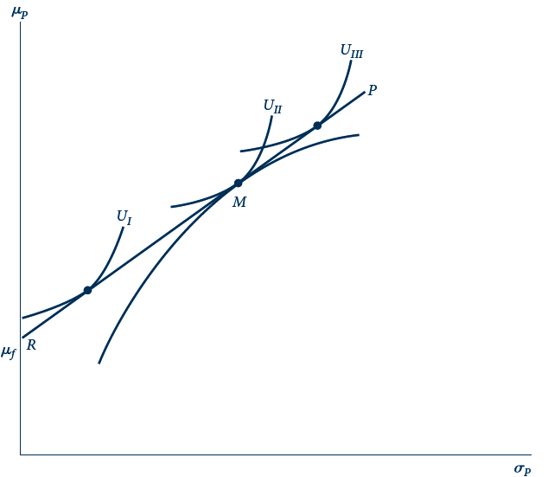
E 7.2 Investor Behavior and Risk Aversion
Given the market options RP, investors can choose how much risk they wish to assume. Very risk-averse investors (U_{I}) will hold mainly risk-free assets, whereas risk takers (U_{III}) will opt for leveraged portfolios.

Slide 93
Mutual funds
Mutual funds
  Pool the funds of many individuals
  Able to achieve economies of scale in transactions and management costs
    Fund owners to share in the fortunes of a much wider variety of equities
  Managers have incentives of their own
  Portfolios they hold may not always be perfect representations of the risk attitudes of their clients

Slide 94
Capital asset pricing model
Portfolio
  Small amount (α) of an asset with a random return x
  Market portfolio, random return M
  Return on the portfolio: z = αx+(1- α)M
  Expected return:
  μ_{z} = αμ_{x} + (1- α)μ_{M}
  Variance:
  σ²_{z} = α²σ²_{x} + (1- α)²σ²_{M} + 2α(1- α) σ_{x,M}

Slide 95
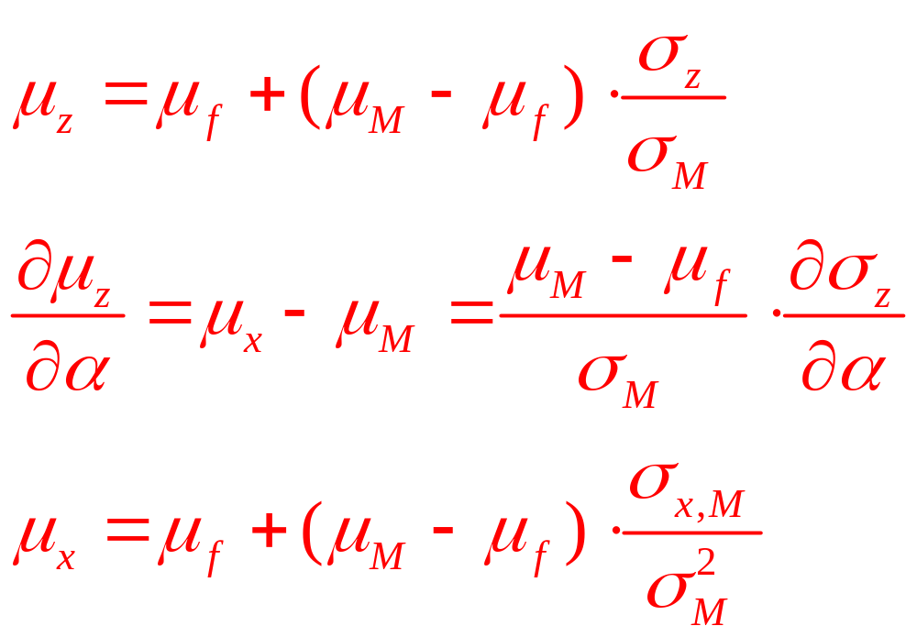
Capital asset pricing model

